Slide 1
Test Driven design
13 May 2025 - Chapter day
Case Study for TDD applied to a Protection Function

Slide 2
Training content
Topics:
Introduction to TDD
Tools and libraries
Code examples, based on a real repo and commits
Possible improvements

Slide 3
Intro to tdd
01

Slide 4
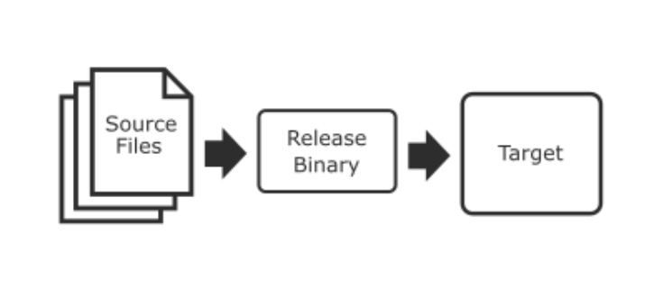
TDD & Embedded Development
Standard Development Process
Dedicated IDE (e.g. Keil MDK)
Dedicated Compiler (e.g. ARM LLVM)
Dedicated Executable file for hw target (e.g. STM32H7)

Slide 5
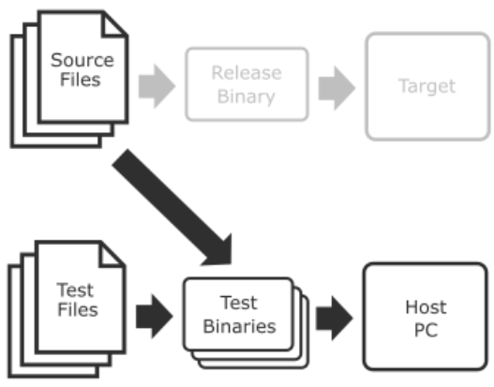
TDD & Embedded Development
Test Process
Separated toolchain (GCC)
Dedicated test files
Test dedicated source files in an isolated environment (PC or Cloud).
Decouple HW from Logic
Simulate HW with mocks
TDD is an addition to Basic Process

Slide 6
What is TDD
TDD is a design technique, not just a testing strategy
Ensures code is testable and maintainable
Forces clearer interfaces and separation of concerns

Slide 7
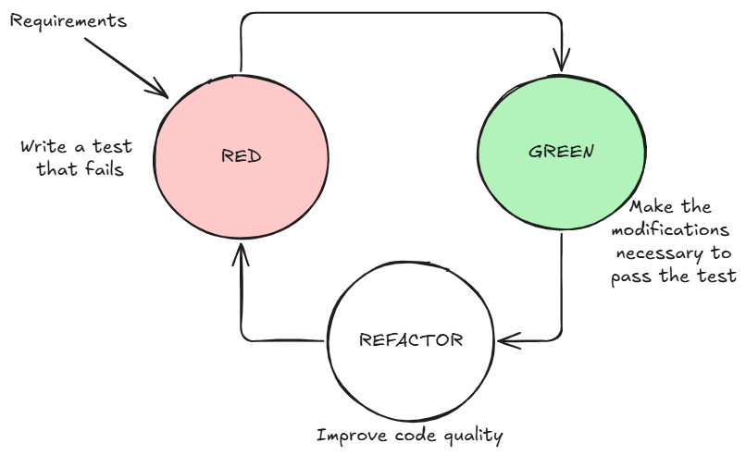
The TDD Cycle
Red-Green-Refactor
TDD Cycle (for each test):
Write a test that fails (RED)
Make it work (GREEN)
Clean-up (REFACTOR)
Repeat until all tests pass and code has desired quality

Slide 8
Why TDD
Reasons behind TDD
Confidence to refactor and evolve design
Improves SW architecture
Tests serve as living documentation
Catch bugs earlier, reduce time spent in debugger
Can be automated
Especially valuable in embedded systems with tight feedback loops

Slide 9
Why TDD
Standards & TDD – UL489 Supplement SE
Requirement | How TDD Helps
Software Verification | TDD ensures software meets requirements with tests covering edge cases.
Traceability of Requirements | TDD enforces traceability of software requirements through test cases.
Automated Testing | TDD integrates automated testing into the development process, ensuring consistency and coverage.
Fault Tolerance | TDD encourages early identification of potential failure modes by testing the code continuously.
Notes:
While UL 489, Supplement SE does not mandate TDD, it encourages practices such as software verification and automated testing that align perfectly with TDD principles, ensuring that electronic trip units perform safely and reliably

Slide 10
TDD vs Traditional Development
Traditional | TDD
Code first | Test first
Manual testing | Automated unit tests
Debug after fail | Fail to guide design
Hard to refactor | Easy to refactor

Slide 11
Misconceptions About TDD
TDD is not just unit testing
TDD doesn’t mean 100% test coverage
TDD doesn’t slow development—it often speeds it up long-term

Slide 12
Summary / What's Next
You now know what TDD is and why it matters
Next: Setting up Unity + CMock for your own tests

Slide 13
Tdd Tools and libraries
02

Slide 14
Installing the C compiler: GCC
GCC is the most widely adopted C compiler
WinLibs standalone build of GCC and MinGW-w64 for Windows - https://winlibs.com/
Chose a version of prebuilt binaries including Clang compilers, for future expandibility
Unzip to c:\mingw64 and add c:\mingw64\bin path to Windows Environment Variables
Next: Setting up Unity + CMock for your own tests

Slide 15
Installing Make
Make is required to build executable file for testing
To Install make binary:
Install Chocolatey from here https://chocolatey.org/install
From an administrator PowerShell, type choco install make

Slide 16
Installing Unity and Cmock
Get the repos
git clone https://github.com/ThrowTheSwitch/Unity.git
git clone https://github.com/ThrowTheSwitch/CMock.git
As a first step, we’re only going to use Unity three source files:
unity.c
unity.h
unity_internals.h

Slide 17
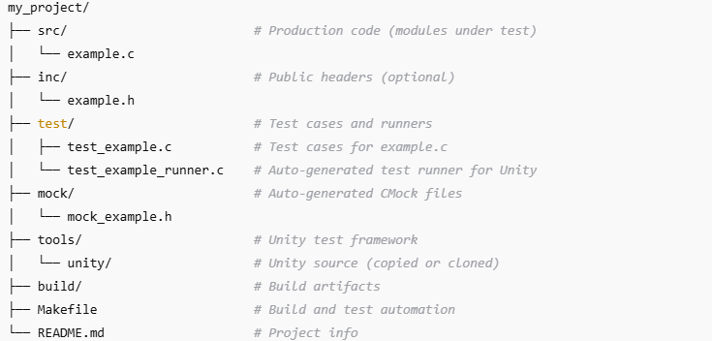
Folder layout with Unity

Slide 18
UNITY ASSERTS
03

Slide 19
Unity Asserts
TEST_ASSERT_X( expected, actual ), where X can be
INT, INT8, INT16, INT32, INT64,
UINT, UINT8, UINT16, UINT32, UINT64,
HEX, HEX8, HEX16, HEX32, HEX64
TEST_ASSERT_GREATER_THAN_X (threshold, actual)
TEST_ASSERT_X_WITHIN (delta, expected, actual)
TEST_ASSERT_FLOAT_WITHIN (delta, expected, actual)
As a first step, we’re only going to use Unity three source files:
unity.c
unity.h
unity_internals.h

Slide 20
SAMPLE FUNCTION
04
Protection Overload

Slide 21
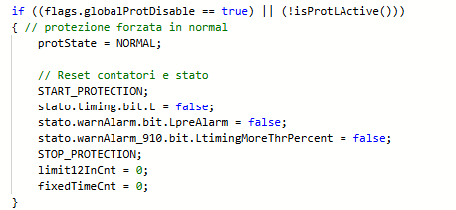
Titan Overload Function: Limitations of codebase
Many interactions with global variables
Access to global variable is aimed at code efficiency, but prevents a clear definition of interfaces.
Code is not testable, due to a great amount of interactions.

Slide 22
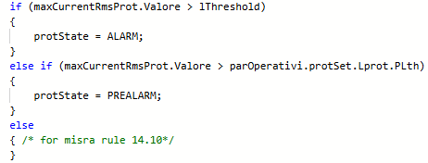
Titan Overload Function: Limitations of codebase
Many interactions with global variables
Access to global variable is aimed at code efficiency, but prevents a clear definition of interfaces.
Code is not testable, due to a great amount of interactions.

Slide 23
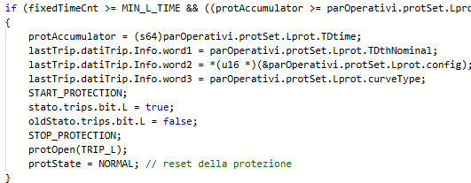
Titan Overload Function: Limitations of system
Calls to other functions
Calls to other functions makes testing mode difficult

Slide 24
Titan Overload Function: Difficulties of system
State Machine
State Machines are more complex to test than single functions:
They need to be called in a repeatedly to evaluate their behavior
They might need to be tested with dynamic inputs to expose complex beavior

Slide 25
1° Step
05
Protection Overload

Slide 26
Protection Overload: 1° Step
Simple example
Trivial state machine implementation (2 states, no state change)
First tests written, checking the state machine status
Trip States: ST_IDLE, ST_OVERLOAD_TRIGGERED
Test can specify a fixed test current and the expected state
Test wait for the expected output state, or
Test is run for the equivalent of one day if expected state is not reached
Result: Tests fail where a state change is expected
Repo tag: v1.1

Slide 27
2° Step
06
Protection Overload

Slide 28
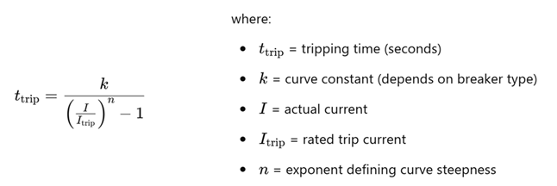
Protection Overload: 2° Step
IEC 60947-2 protection
Added IEC 60947-2 inverse-time formula to mimic overload protection behavior. The general inverse-time trip equation follows:
Result: trip happen where expected (I/Ir > 1.15f)
Repo tag: v1.1

Slide 29
3° Step
07
Protection Overload

Slide 30
Protection Overload: 3° Step
Variable currents
By adding this capability more complex input currents can be simulated
Delay in current instauration
Intermittent currents
Result: trip happen where expected (I/Ir > 1.15f), with delays or intermittent currents
Repo tag: v1.3

Slide 31
Future Extensions
08

Slide 32
Future TDD possible extensions
Testing on ARM emulator (QEMU)
Using same compiler (CLANG)
Investigate Testing frameworks
Unity/Ceedling
Gtest
Other

